Slide 1
IPR 1: Rotary Inverted Pendulum (Ret.)
CDT Wesley Swain

Slide 2
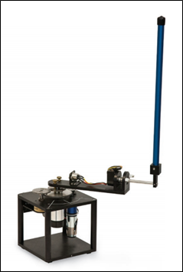
Problem Domain
Quanser Rotary Inverted Pendulum
Hardware availability
Project goal (plan for use)
Model output
Training for task
- Online
- Offline

Slide 3
Project Data
Reinforcement Learning
- Open AI: Spinning Up in Deep RL
- Model training (understanding intermediate data)
- Proximal Policy Optimization (on-policy, discrete actions)
- https://spinningup.openai.com/en/latest/index.html
Offline Learning
- Extract model
- Retrain model
- Display project

Slide 4
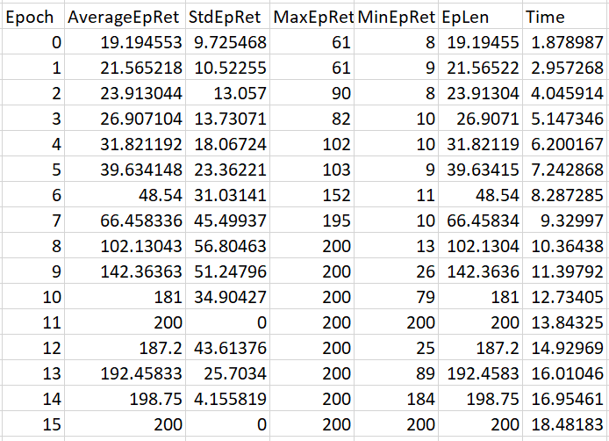
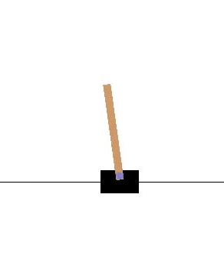
Cartpole Training Summary
As specified in cartpole_ppo.sh, this is a summary of training over 16 epochs, using PPO with a small neural net [16,8,4]
Impossible to use all spinningup tools in Colab

Slide 5

Draft Proposal: Wesson
CDT Wesley Swain

Slide 6
Wesson: Tackling Jeopardy!
Project Goal: To train a neural network to achieve acceptable question answering success on Jeopardy-style questions with minimal computing resources
Problem Description: Scope undefined, research limited
Preceding Work: Watson (DeepQA), strong NLP models
Potential Datasets: JArchive, Protobowl
First Source: “Building Watson: An Overview of the DeepQA Project” (copy in repo under wesson/building_watson.pdf)

Slide 7
Questions?
GitHub:
https://github.com/westpoint-neural-networks/final-project-wjwswain

